Slide 1
Board of County Commissioners
Regular Meeting
May 21, 2026
5:30 p.m.
Columbia County School Board Administrative Complex

Slide 2


Slide 3
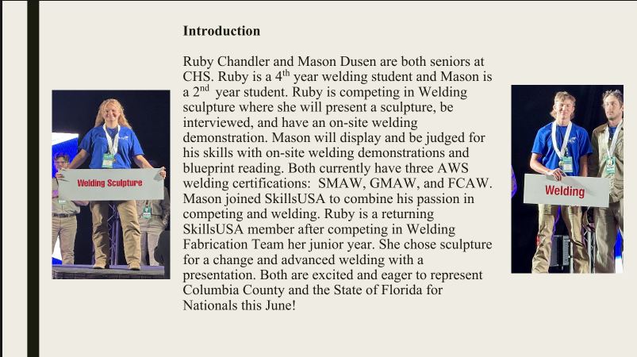

Slide 4
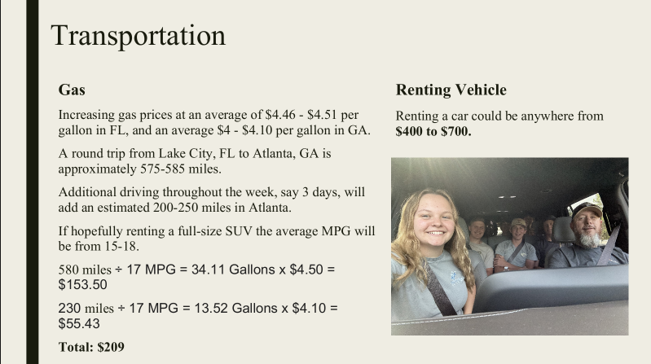

Slide 5
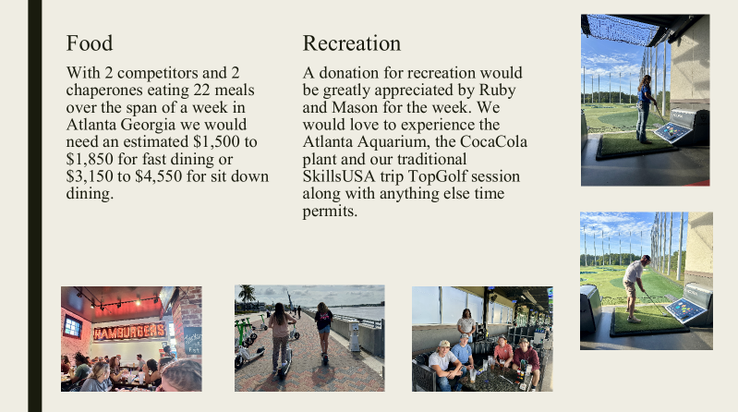

Slide 6



Columbia County 4-H Youth Leadership & Scholarship Impact
Thank you for investing in Local Youth!

Slide 7

4-H Zoo Apprentice Camp
Hands-on animal science education
Career exploration in zoology & veterinary fields
Leadership, responsibility, and teamwork
Behind-the-scenes learning experiences

Slide 8
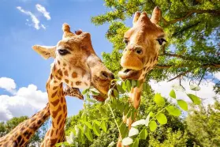
By Zariel Phinazee
Zoo Camp Trip
4H
Zoo Apprentice Camp
Zoo Apprentice Camp

Slide 9
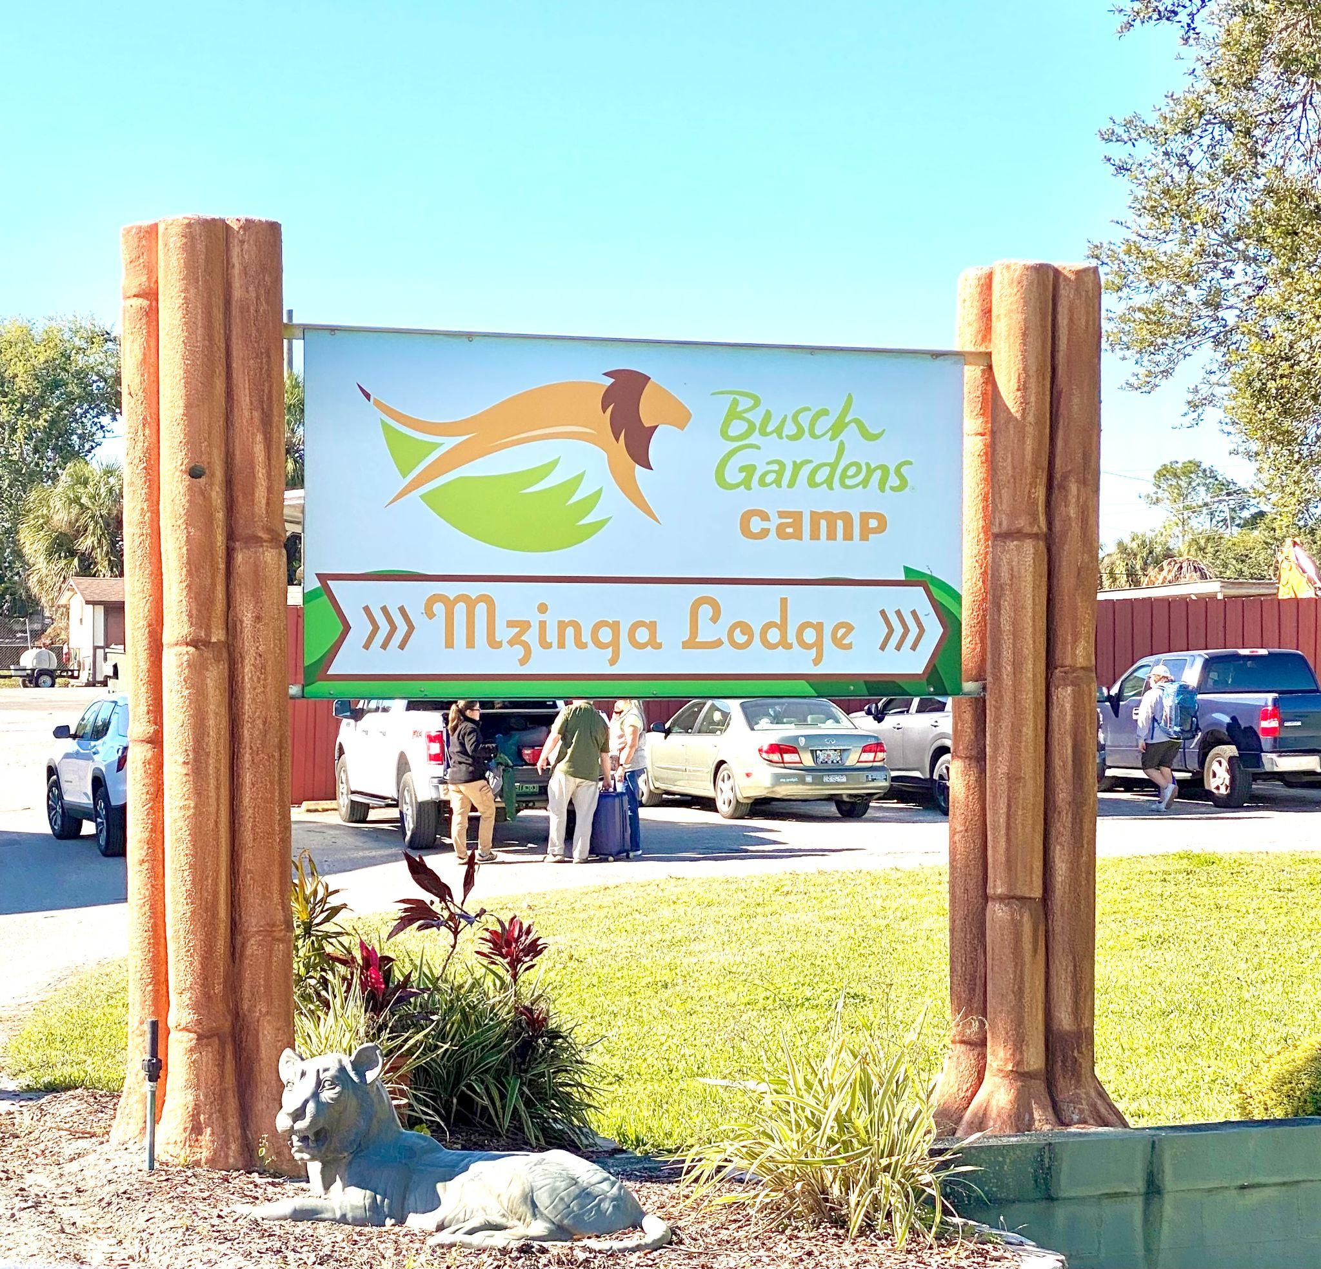
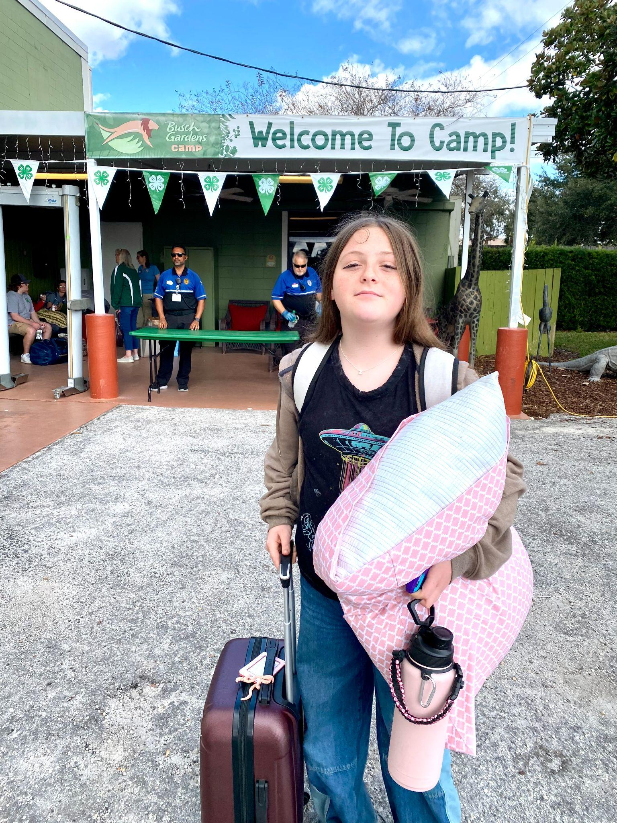
Here begins the start to my life changing experience.

Slide 10
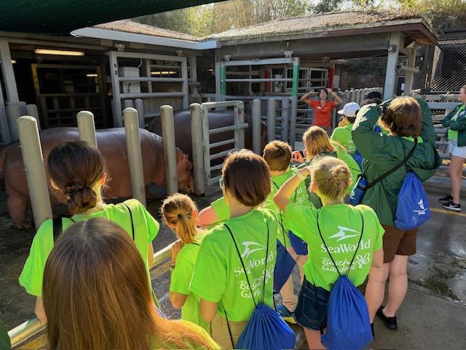
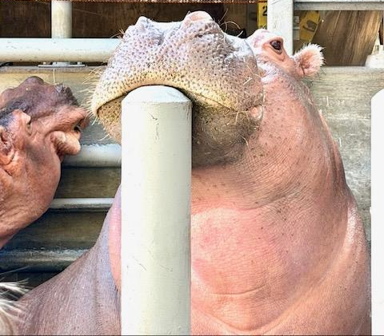
First I want to talk about how I got to learn new facts about hippopotamuses!

Slide 11
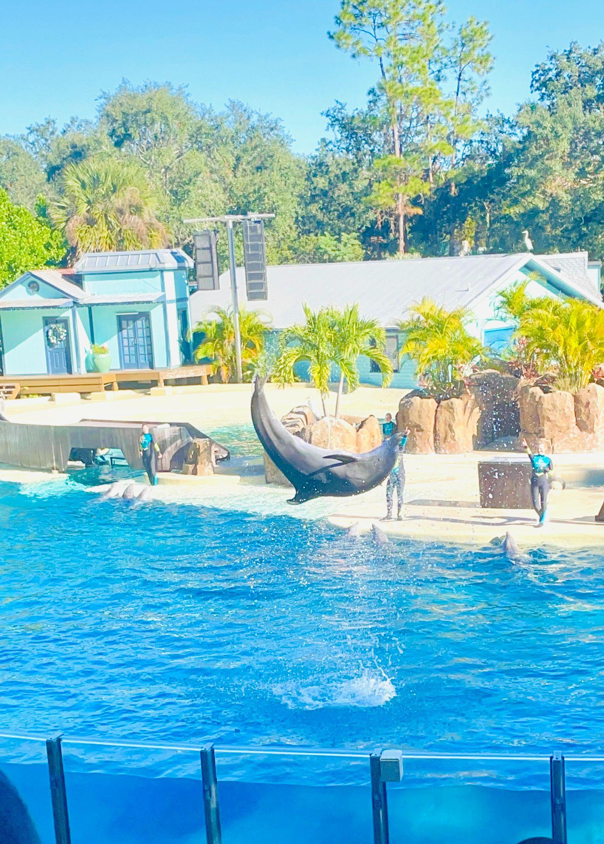
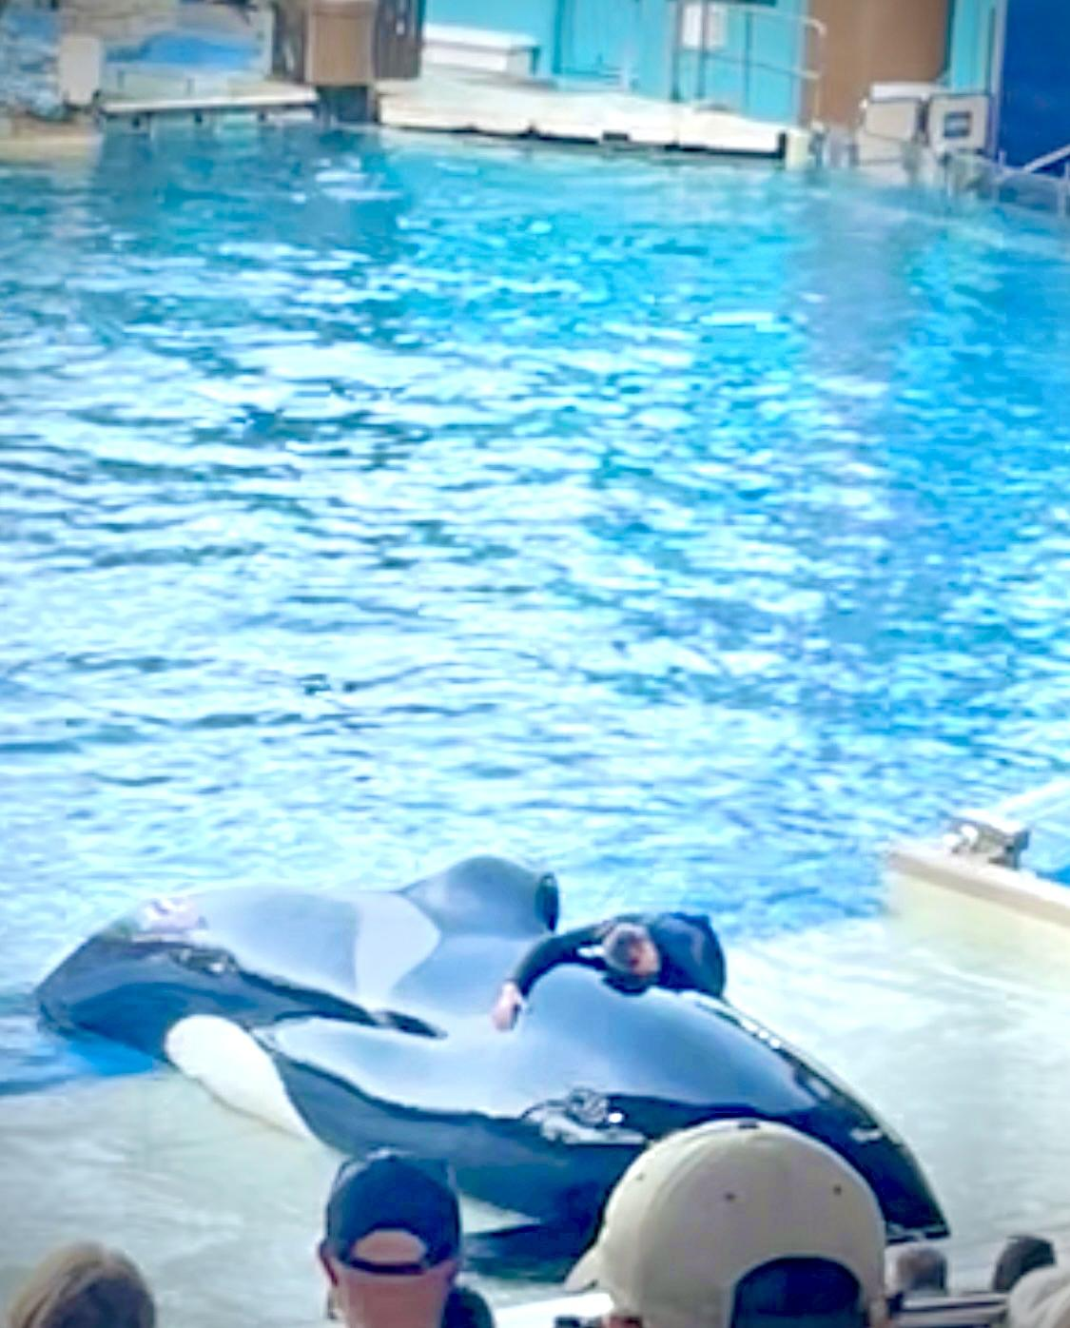
I also had the opportunity to go to a water performance featuring dolphins and orca whales.

Slide 12
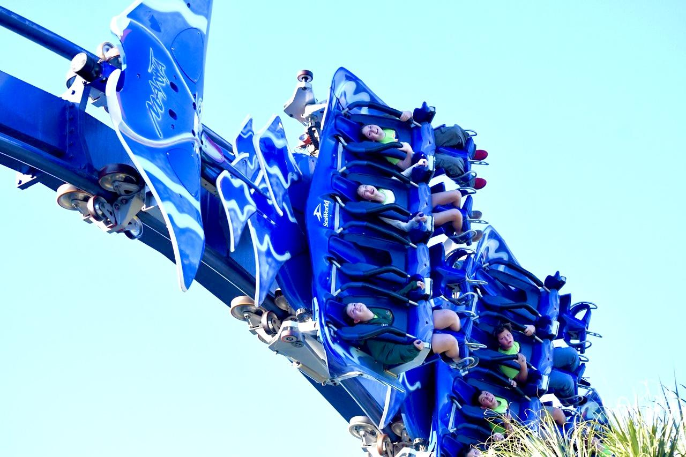
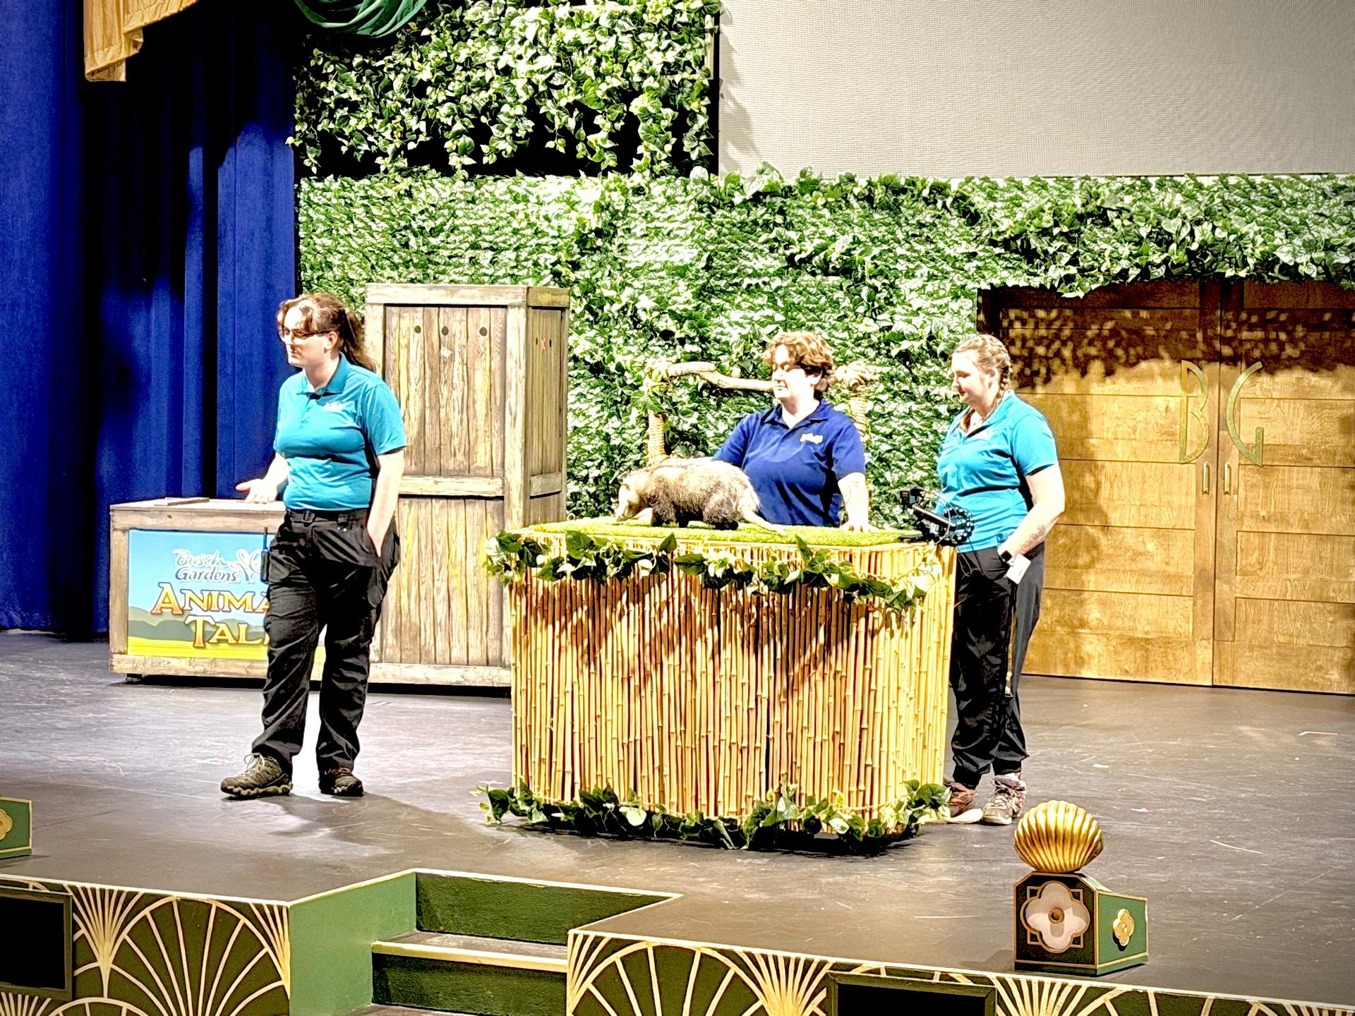
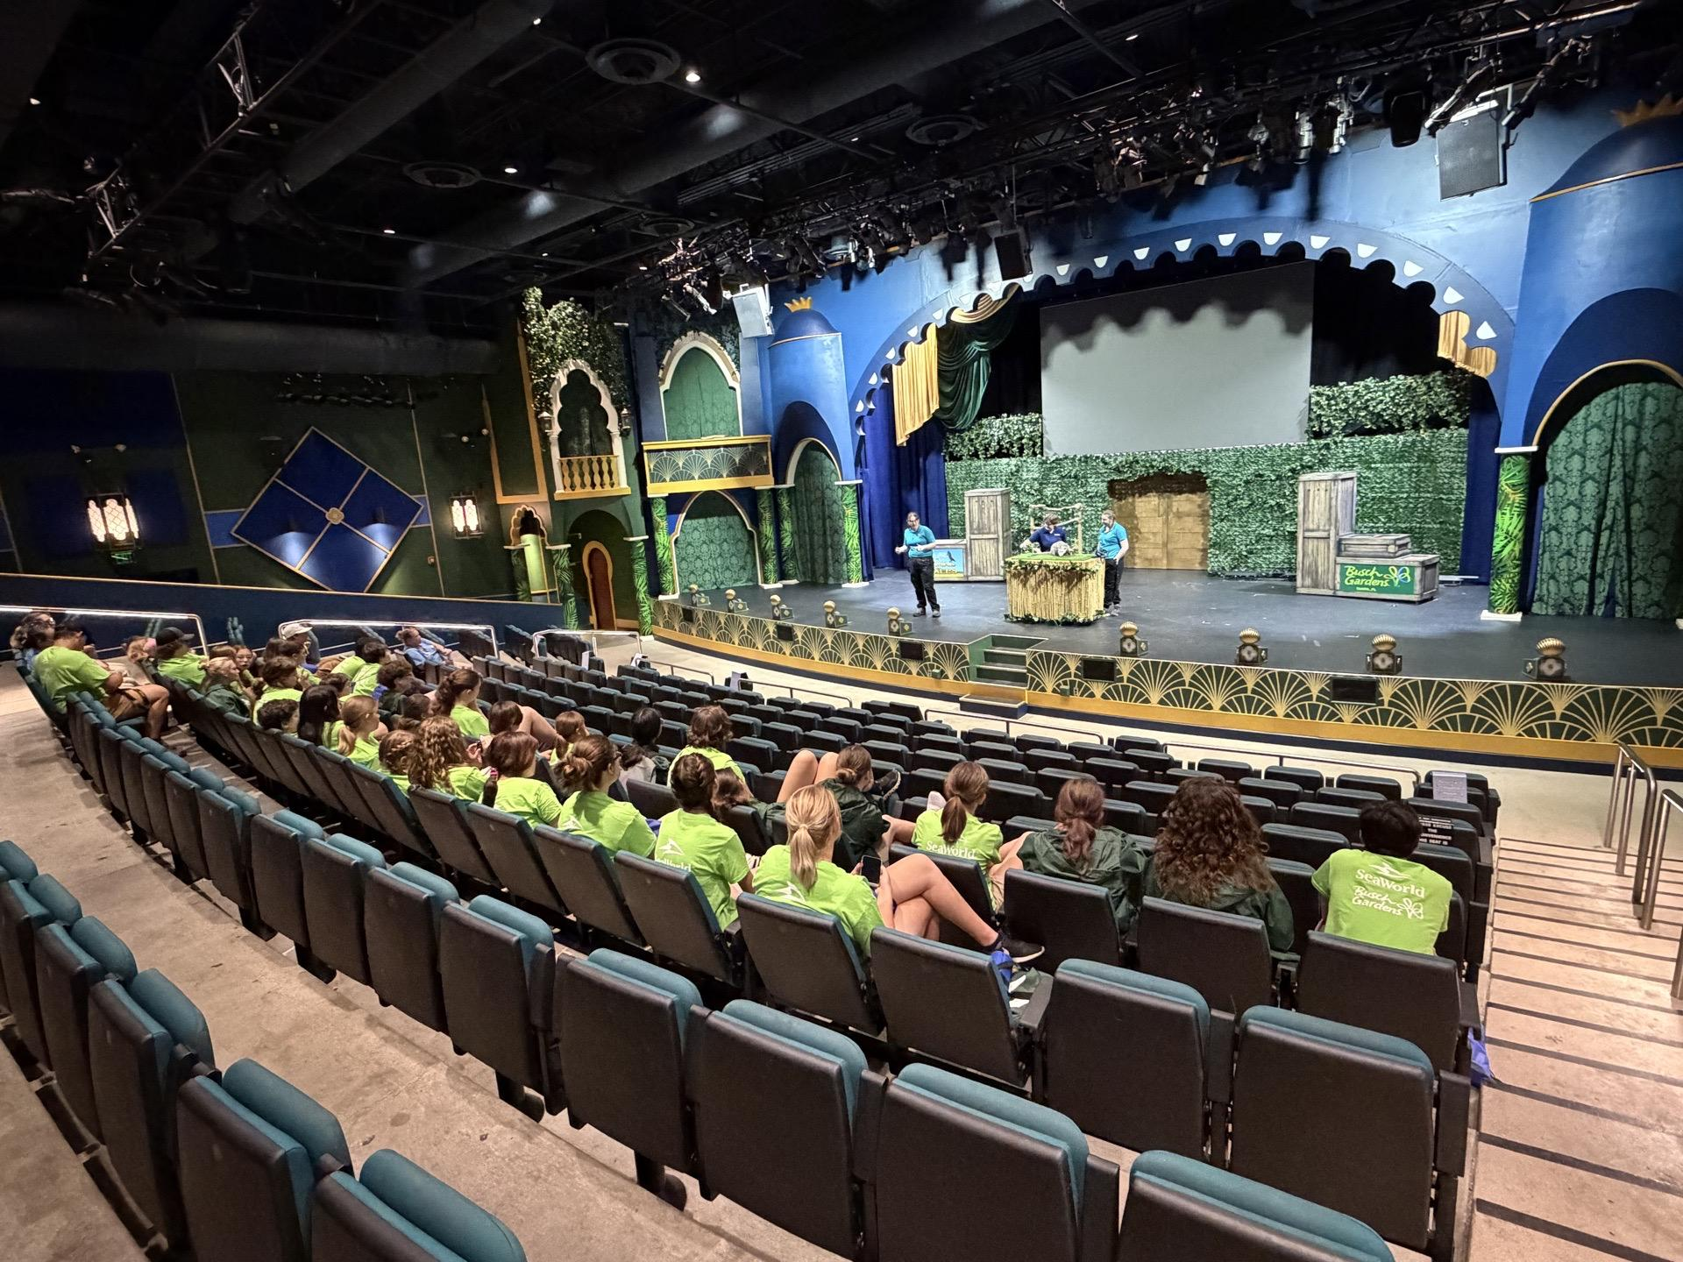
Here we went to a private learning experience were we asked questions about possums.

Slide 13
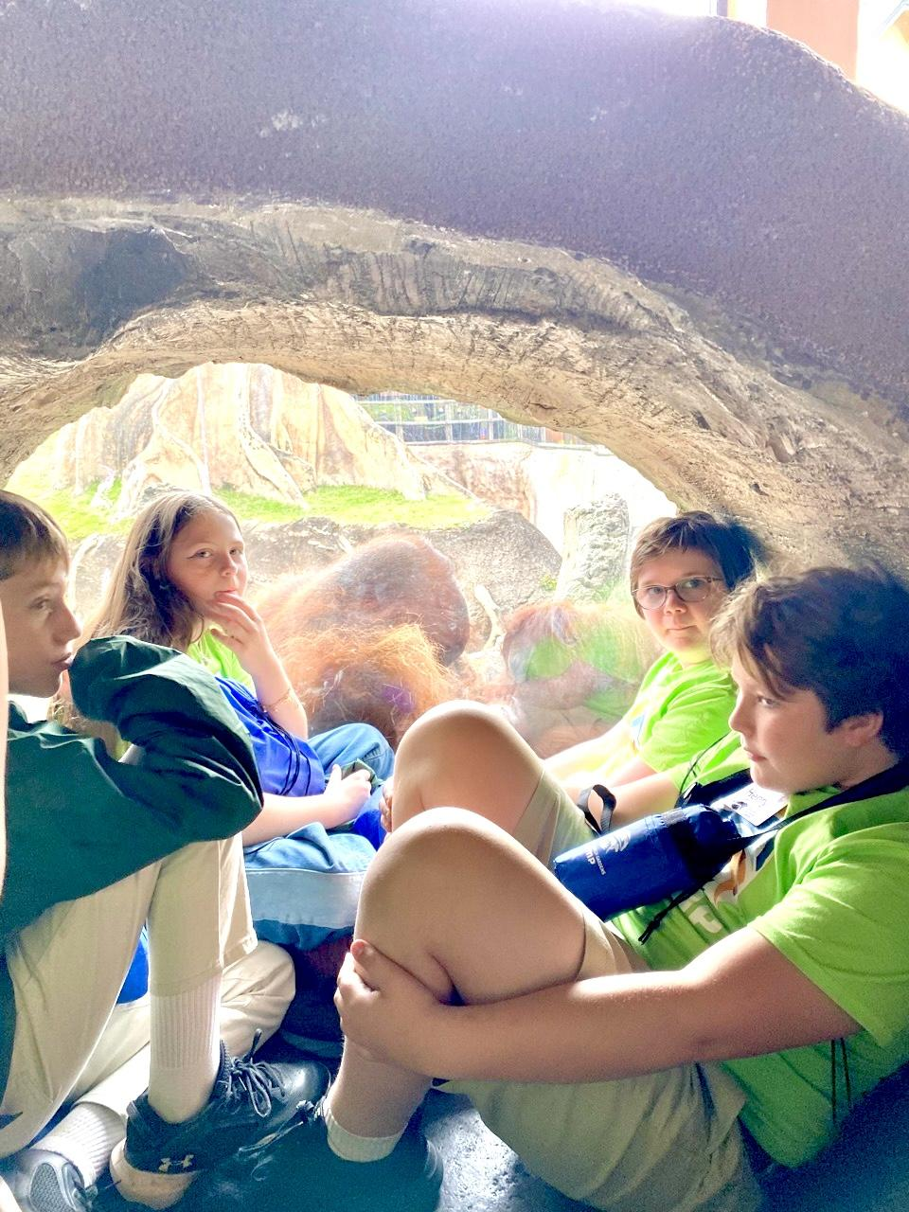
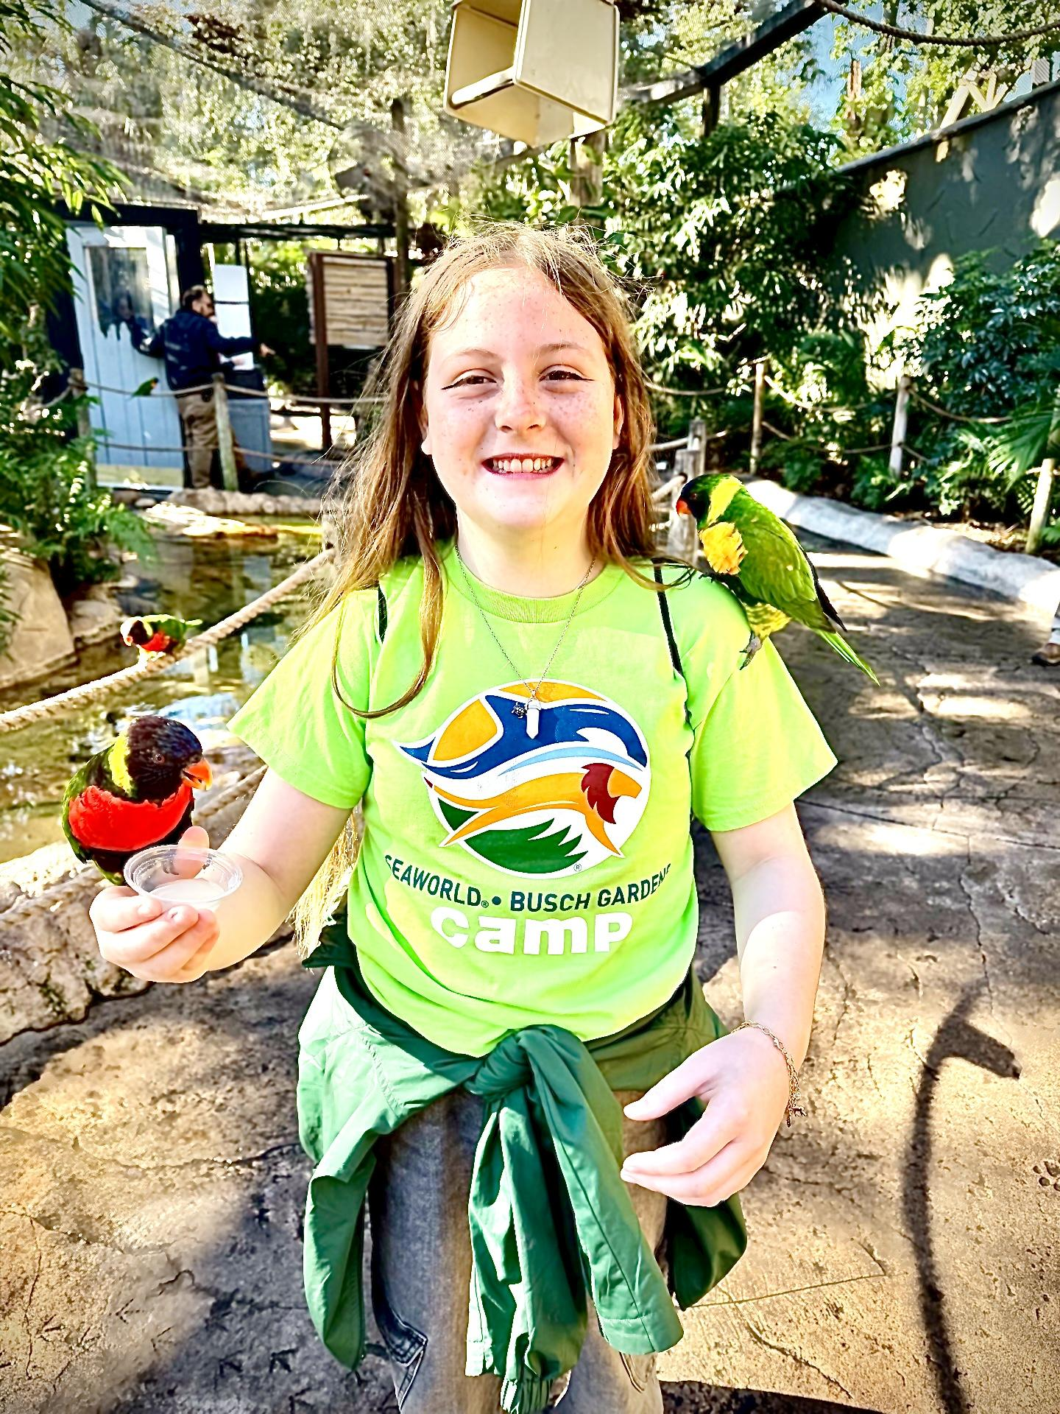
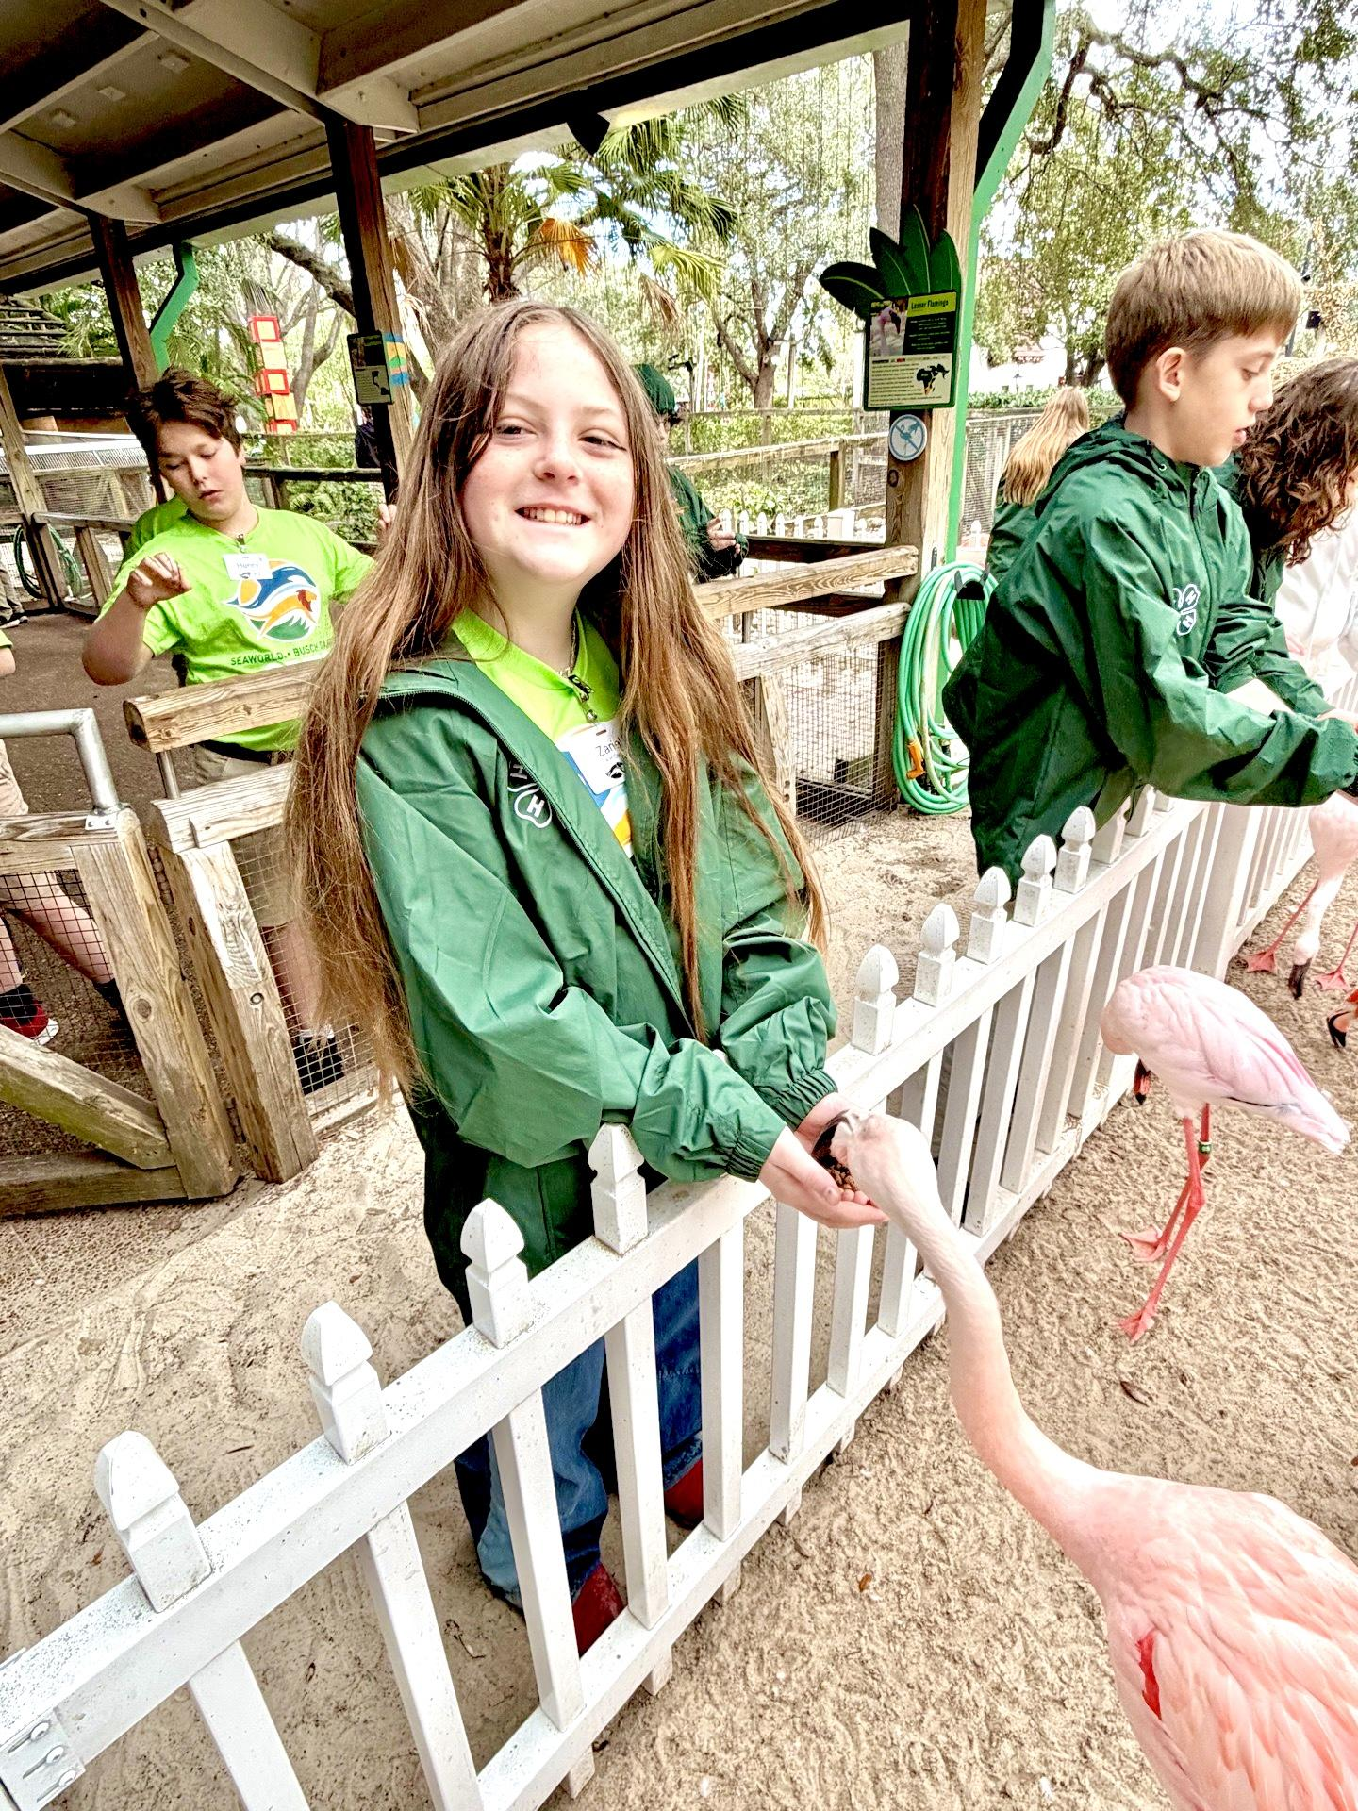
Then we got to feed un-native birds and flamingos, but we had to remember to not touch them!

Slide 14
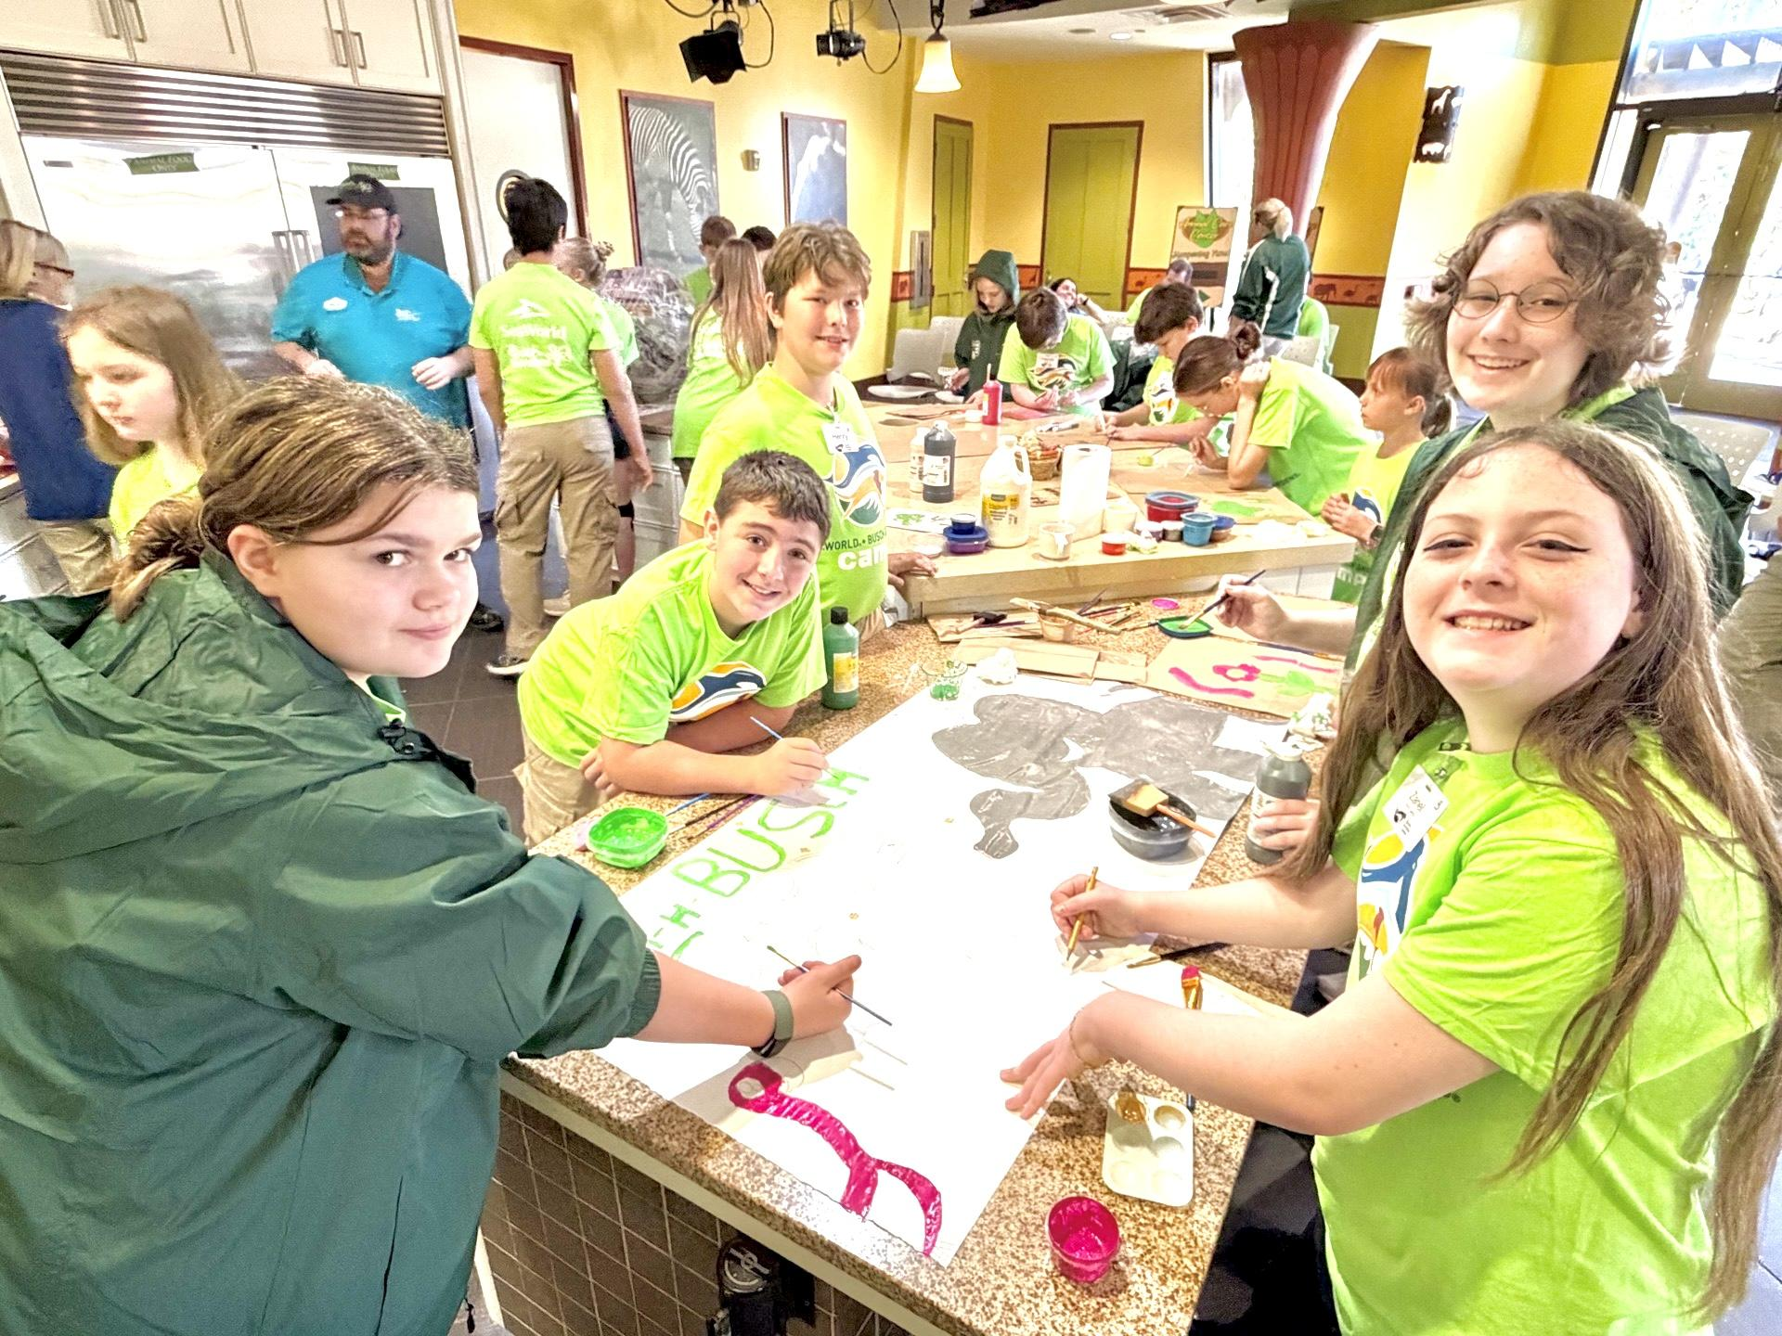
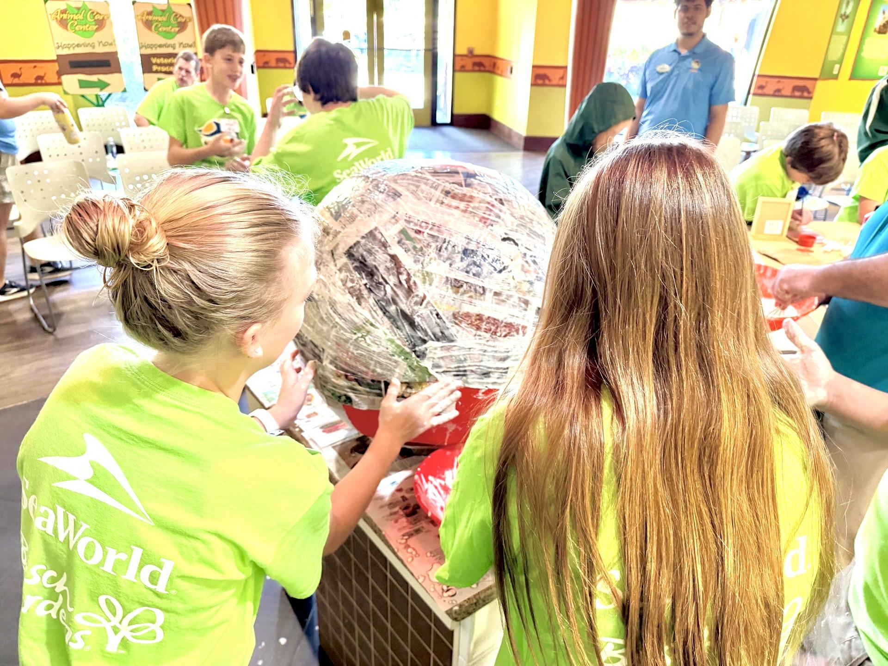
We got to make toys for Sea World's oldest elephant, which was really fun!

Slide 15

Lastly I want to thank you for giving funds to 4-H and giving kids a once in a lifetime experience to cherish and never forget. And I’m so blessed to have been given this opportunity . I thank you guys alot.

Slide 16
Board of County Commissioners
Regular Meeting
May 21, 2026
5:30 p.m.
Columbia County School Board Administrative Complex

Slide 17
Traffic Signal Technician I Position
Creating a succession plan in the Public Works Sign Shop with an entry-level position.
Recommended Motion: Approve Traffic Signal Technician I position

Slide 18
RFP 2026-F Cumorah and Jail Tower Decommissioning – Globenet Telecommunications, LLC - $232,660.00
April 16, 2026, BOCC approved staff to negotiate with Globenet Telecommunications, LLC.
Scope of work includes providing professional services for the dismantling and decommissioning communication structures at two (2) County owned sites.
  Cumorah Hill
  Jail Tower
Recommended Motion: Award agreement for RFP 2026-F to Globenet Telecommunications for the proposed amount $232,660.00.

Slide 19
Board of County Commissioners
Regular Meeting
May 21, 2026
5:30 p.m.
Columbia County School Board Administrative Complex

Slide 20
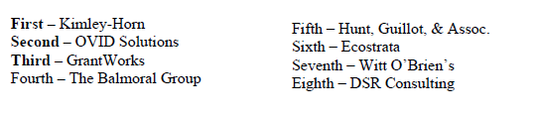
RFQ 2026-H
Grant Administration and Writing Services
RFQ 2026-H sought firms for grant administration and grant writing services for future projects yet to be named.
RFQ 2026-H received ten (10) responses and eight (8) were deemed responsible and responsive
Staff recommends the Board to authorize negotiations with the top 3 ranked firms
Recommended Motion: Approve the ranking of firms and authorize staff to negotiate with top three ranked firms

Slide 21
RFP 2026-E
CDBG Grant Administration
The Department of Commerce awarded Columbia County a Small Cities Community Development Block Grant for Housing Rehabilitation for $1,225,000.00
The Commission approved a ranking for CDBG Housing Grant Administration contractors on May 7, 2026 with Public Consulting Group as top firm
This Agenda item approves the agreement to administer this specific grant
Recommended Motion: Staff recommends the Board to approve the Agreement with Public Consulting Group for RFP 2026-E

Slide 22
Memorandum of Understanding
Florida Division of Emergency Management
On February 19, 2006, the County approved a Notice of Intent to participate in the Elevate Florida program
MOU defines the County's and State roles and responsibilities under the acquisition and demolition element of Elevate Florida
The State will purchase the property at no cost to the County; the County will assume the maintenance expenses
The County will also ensure no construction on property; notification of adjacent property owners; only sold to another public entity; reports to FEMA every 3 years; no additional disaster funds applied for this property; and FEMA and FEMA contractors have access to the property
Recommended Motion: Approve Memorandum of Understanding with Florida Division of Emergency Management

Slide 23
BA 26-35
Rural Spring Grant Agreement
The State of Florida Emergency Communications Board awarded the grant requests approved by the Board of County Commissioners on 3/19/2026
Item is for acceptance of the grant agreements and to create the budget for the grants
Recommended Motion: Accept Grant agreements and approve BA 26-35

Slide 24
Code of Ethics
Discussion and Possible Amendments
Discuss possible amendments to the Code of Ethics
Discussion

